Slide 1
Waste management in Rajasthan and Maharashtra
GCL
Presented by : Eco Warriors
WET WASTE
DRY WASTE

Slide 2
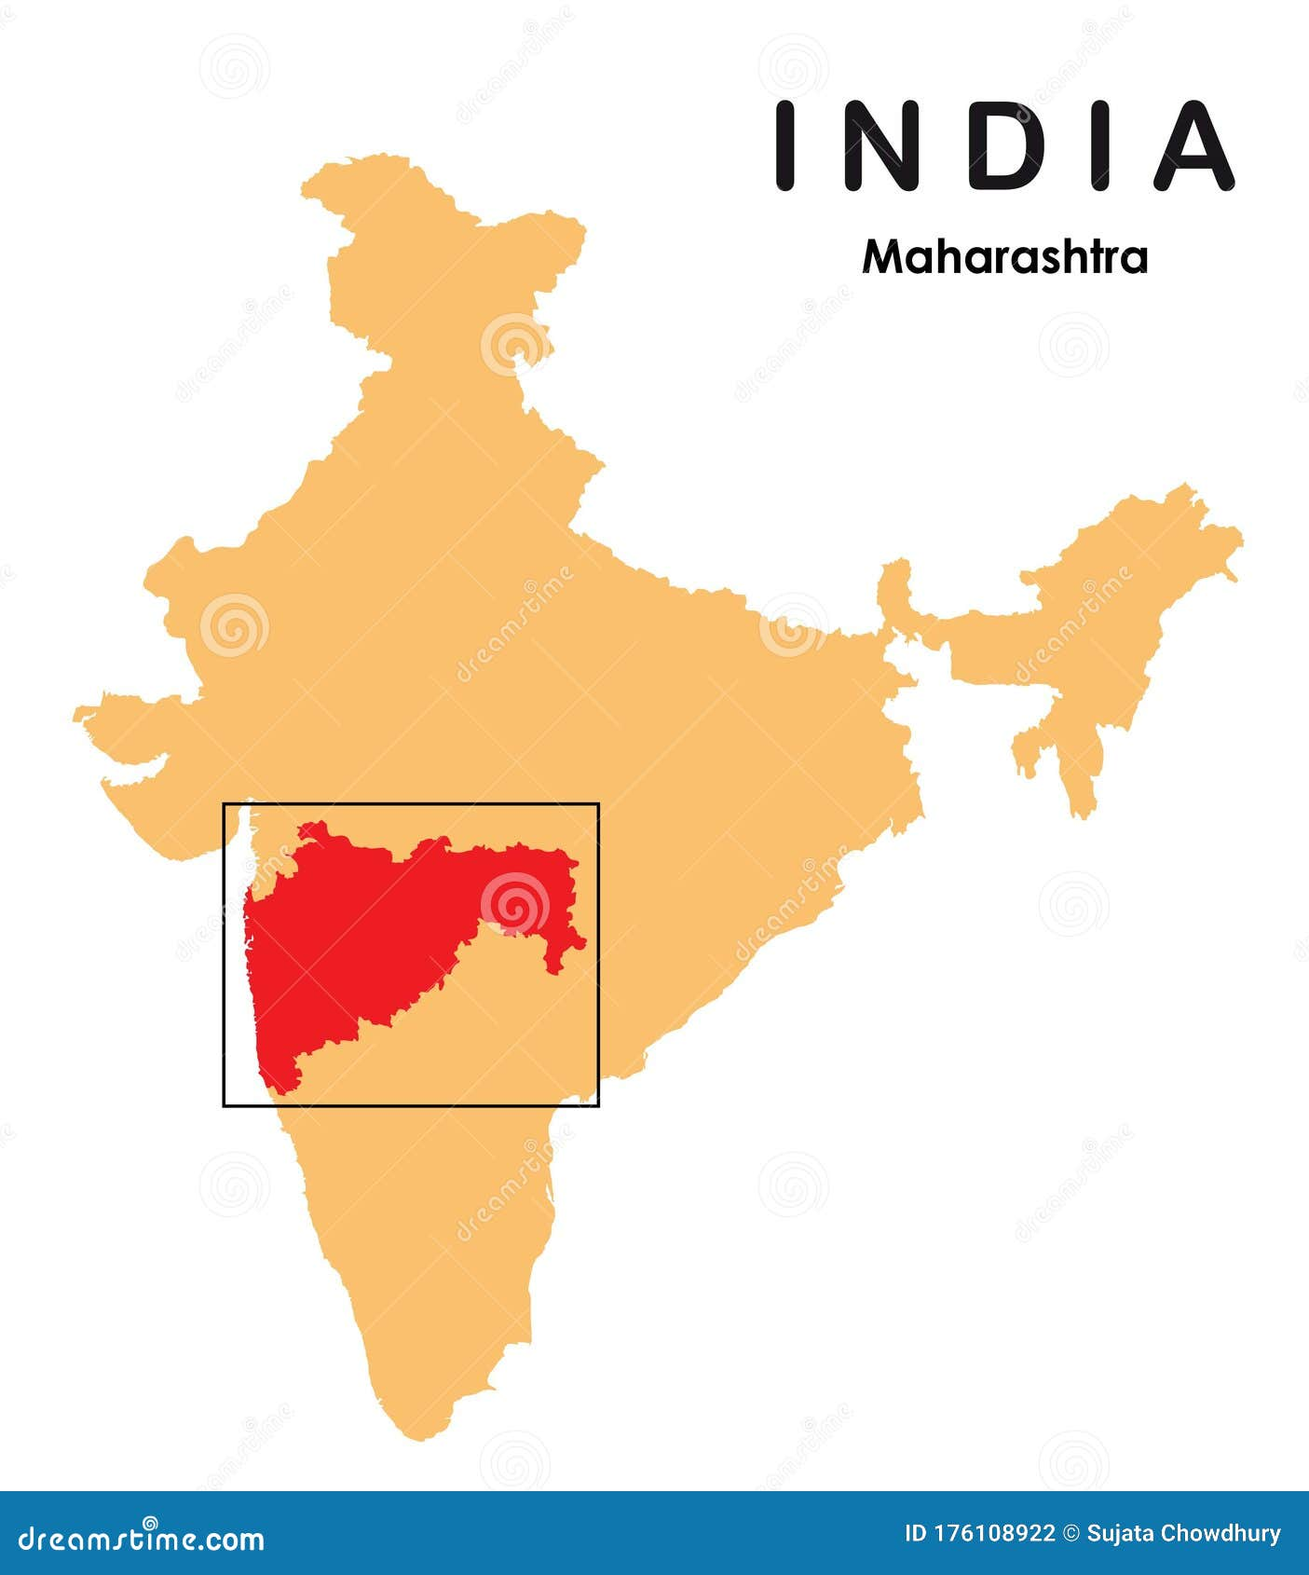
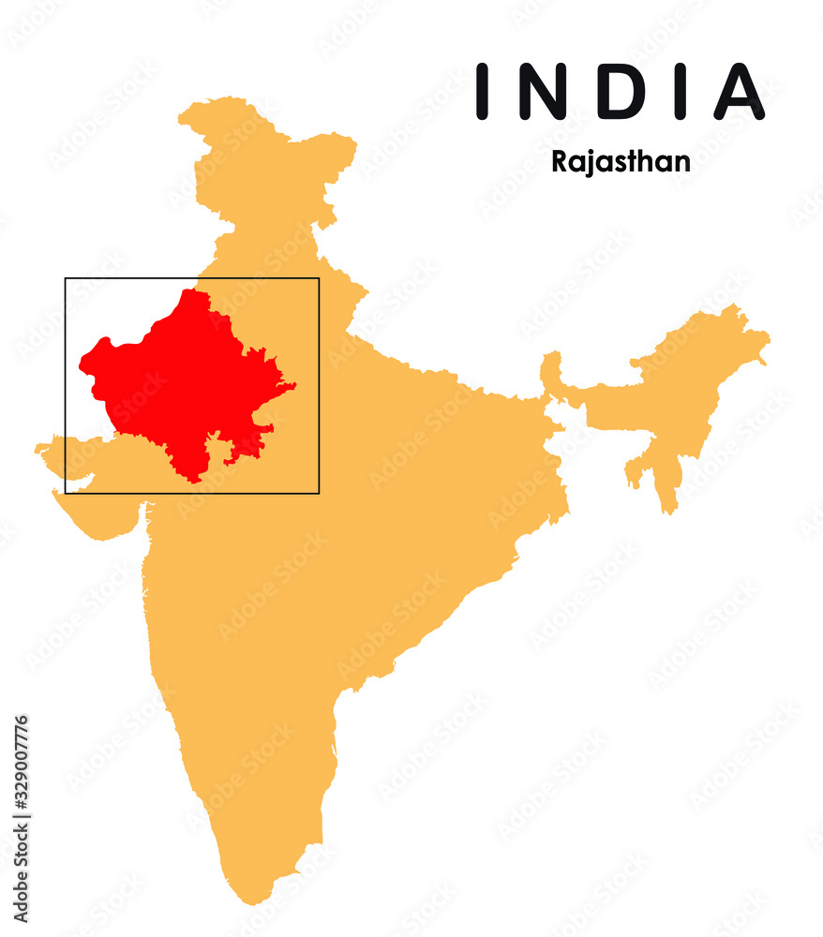
Problem Statement
Waste management in Rajasthan and Maharashtra faces challenges of urban waste, plastic pollution, infrastructure gaps, and inadequate segregation systems

Slide 3

VISION
MISSION
To redefine waste management by transforming urban challenges into opportunities for sustainable growth, fostering cleaner cities, empowered communities, and a greener planet.
To revolutionize waste management in Rajasthan and Maharashtra by implementing innovative segregation systems, promoting sustainable practices, and empowering communities to minimize environmental impact.

Slide 4
CORE VALUES
IDNTIT
SENSOR
PANEL ADMIN
BOXED
NOTIFICATION
Innovation
Leveraging cutting-edge technologies and creative approaches to transform waste management practices.
Sustainability
Promoting eco-friendly solutions that minimize environmental impact and ensure long term benefits.
Community Empowerment. Engaging and educating local communities to take active roles in sustainable waste practices
Adaptability
Continuously evolving strategies based on feedback, research, and emerging waste management trends.
Transparency
Ensuring accountability and openness in project design implementation, and evaluation​
Collaboration
Building partnerships with stakeholders, goverment bodies, and organizations for impactful outcomes

Slide 5


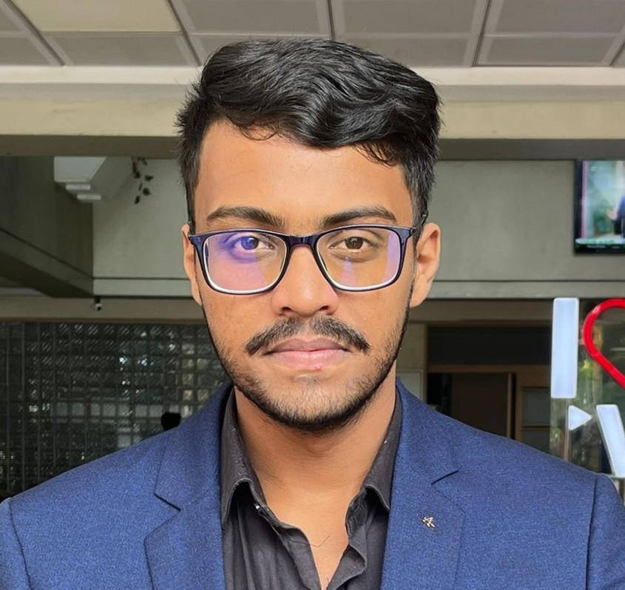




Team Charter
Vaibhav Bhartiya
Raghav Shrivastava​
Shantanu Wankhede​
Community Engagement Coordinator
Research Coordinator
Technical Lead & Implementation Strategist
Shweta Jadhav​
Rudra Shekhar Mazumder​
Aditi Sinha​
Community Engagement Specialist
Operational Support
Financial Oversight & Data Analysis

Slide 6
Strength and Weakness
Aditi Sinha | Strong critical thinking and problem-solving abilities Keen observer with attention to detail Curiosity and eagerness to learn Analytical mindset for data-driven decision making | Slow decision-making in high-pressure situations Introverted nature in group settings Easily distracted, especially in less structured environ
Shweta Jadhav | Creative and innovative problem solver Highly detail-oriented, ensuring accuracy in work Strong empathy and ability to connect with others Skilled in problem-solving, finding practical solutions | Procrastination in task initiation Emotionally vulnerable, leading to stress under pressure Impatience with slow-moving processes Self-critical, often doubting personal work quality
Rudra Mazumder | Strong innovative thinking and creative solutions Excellent communication and interpersonal skills Team-oriented with leadership capabilities Ability to drive projects as a leader and motivator | Tends to be emotional under stress, affecting decision-making Procrastination in non-urgent tasks Blunt communication style, which may sometimes create friction Struggles with saying "No", leading to Overcommitment
Vaibhav Bhartiya | Strong communication skills for effective collaboration Excellent at observation and providing valuable insights Skilled in building connections and fostering relationships. | Issues with voice pitching, making communication less effective at times Difficulty with task completion due to shifting focus Aiming for perfection can lead to delays in progress Struggles with decision-making, often overanalyzing situations
Shantanu Wankhede | Strong leadership and mentorship skills Analytical thinking and problem-solving capabilities Proficient in SAP MM and Excel, with a technical approach Committed to continuous learning and adaptability | Procrastination when faced with overwhelming tasks Tendency to overthink, delaying decisions Time management struggles under multiple deadline Hesitation to delegate, leading to personal workload overload
Raghav Srivastava | Detail-oriented and focused on ensuring quality work Excellent team player, collaborating effectively Sincere and time-oriented in meeting deadlines Highly flexible, adapting to different work situations | Uncomfortable with public speaking, leading to hesitancy in presentations Insecure at times, affecting confidence in decision-making Tendency to procrastinate on non-urgent tasks Perfectionist, which can delay task completion

Slide 7
Secondary Research with Citation
Secondary Research Findings
1. Introduction to Waste Management Challenges
• Rajasthan and Maharashtra face significant issues due to:
• Rapid urbanization and increased municipal solid waste (MSW) generation.
• Insufficient segregation systems and poor waste infrastructure.
• Rising plastic waste levels, with Maharashtra contributing over 13% of India’s plastic waste.
• Both states need immediate policy interventions and technological upgrades.
2. Key Insights from Rajasthan
• Jaipur Waste-to-Energy Plant:
• Processes 1,000 tons/day, generating 12 MW electricity.• Model for scalable urban waste solutions.• Biomass and Waste-to-Energy Policy, 2023:
• Focus on creating green energy from biomass and urban waste.
• Offers incentives like land allotment and financial assistance.
• Smart City Integration:
• Udaipur employs data-driven waste audits to identify gaps in MSW management.

Slide 8
3. Key Insights from Maharashtra
• Mumbai’s Decentralized Waste Systems:
• Community-driven models like vermicomposting and waste segregation achieve 90% landfill reduction.
• Biogas Plants in Nashik (Gobardhan Scheme):
• Utilizing organic waste to produce sustainable energy while reducing landfill pressure.
• AI and IoT Integration in Pune:
• Piloting AI-based waste segregation for real-time tracking and predictive logistics.
4. Overarching Insights for Both States
• Policy and Technology Interventions:
• Emphasize source segregation, waste-to-energy projects, and circular economy practices.
• Informal Sector Integration:
• Leveraging the contribution of waste pickers for recycling and recovery systems.
• Public Awareness:
• Campaigns like 5R Approach (Reduce, Reuse, Recycle, Recover, Remove) to drive behavior change.

Slide 9
Recommendations
• Adopt Decentralized Waste Management:
• Localized composting and biogas facilities for organic waste.
• Expand Waste-to-Energy Initiatives:
• Scale successful models from Jaipur and Mumbai to other cities.
• Implement Circular Economy Models:
• Promote micro-factories and upcycling initiatives for plastics and e-waste.
• Digitization of Waste Systems:
• Integrate AI and IoT for predictive logistics and segregation systems statewide.
6. References
1. Gören, S. (2015). Sustainable Waste Management. IGI Global.
2. Rajasthan Biomass and Waste-to-Energy Policy, 2023. Rajasthan State Document.
3. Deshmukh, S., & Mahajan, K. (2015).
Role of Informal Sector in E-Waste Management. IJCA.
4. Gutberlet, J. (2018). Waste in Urban Agglomerations. IntechOpen.

Slide 10
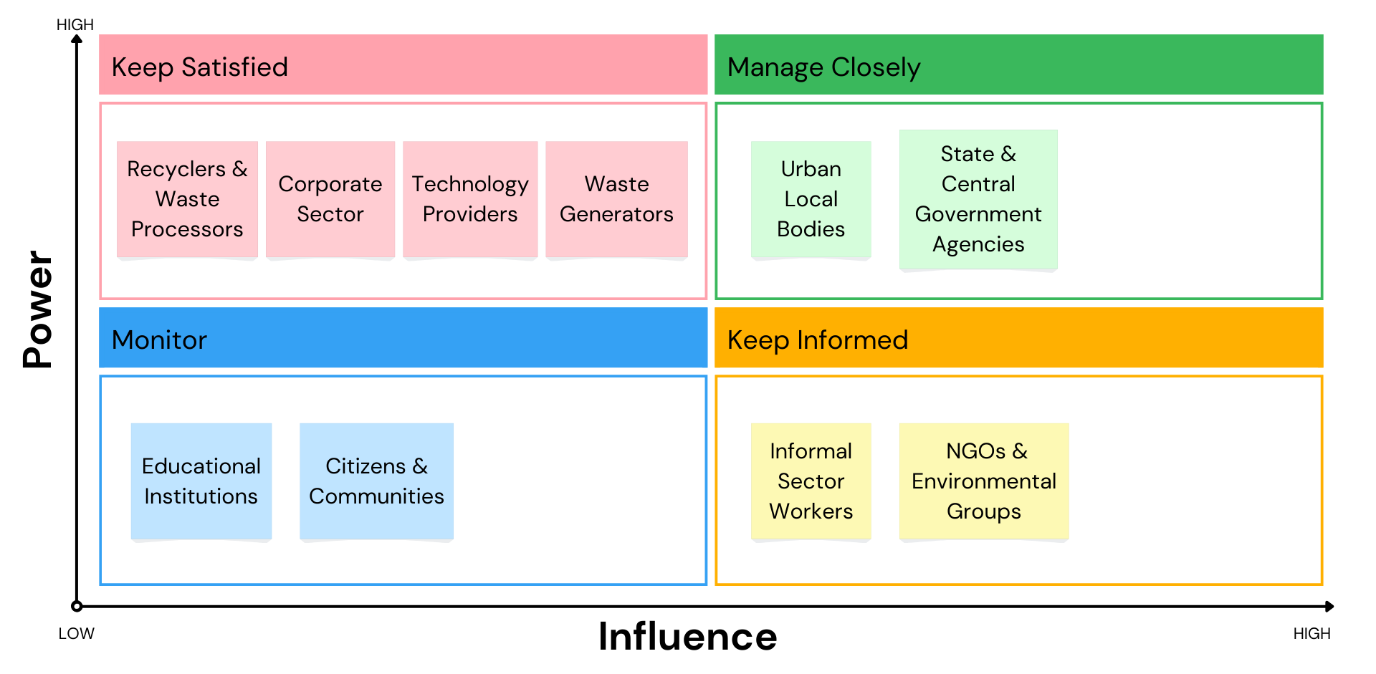
Stakeholder Mapping

Slide 11
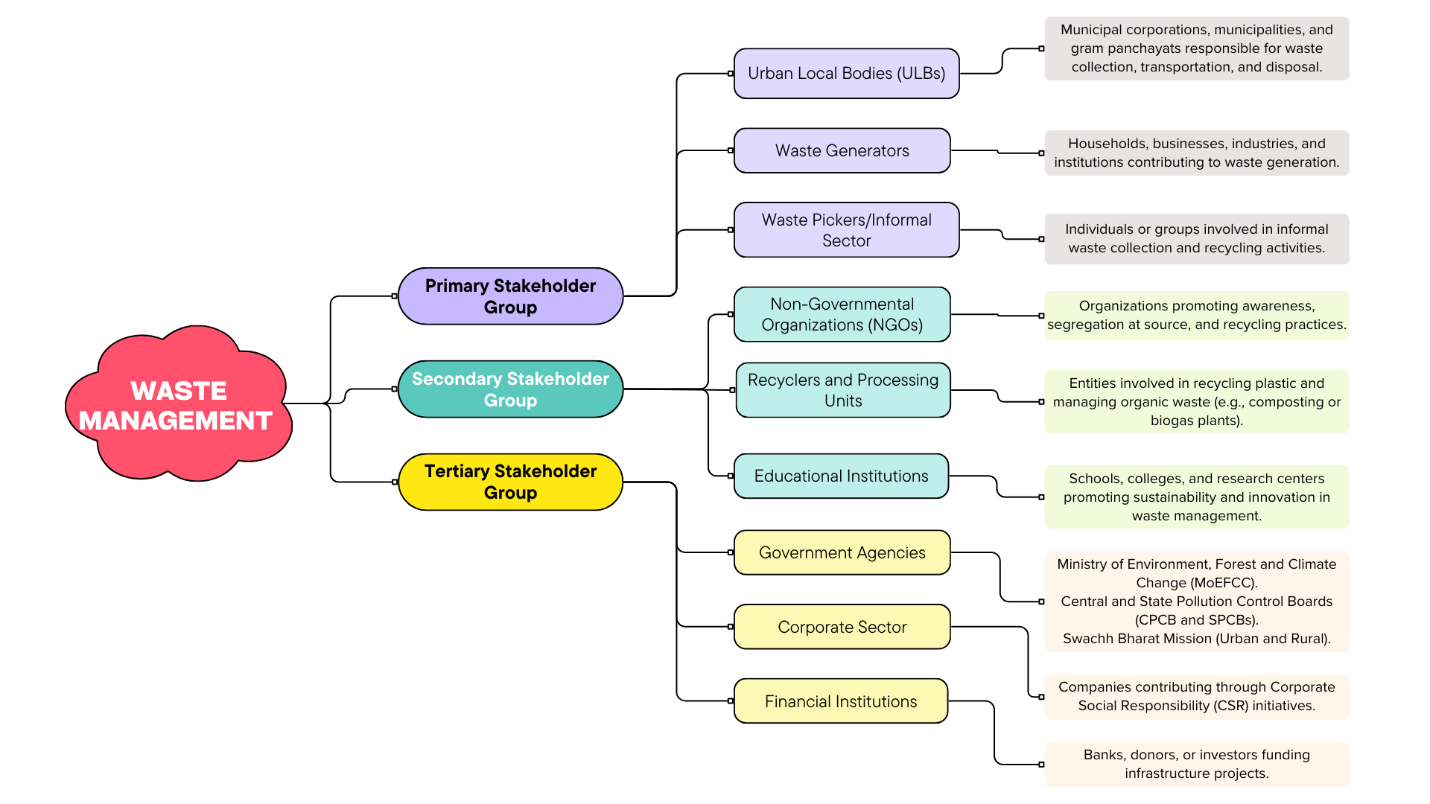

Slide 12
User Journey Mapping
STAGES | USER ACTIONS | TOUCHPOINTS | PAIN POINTS | PROPOSED TECHNICAL SOLUTIONS
AWARENESS | Recognize waste disposal issues Search for information -Attend awareness events | Social media - Digital ads Community programs | Lack of awareness about proper segregation Minimal long-term waste impact knowledge. | Launch targeted AI-driven campaigns social media. Use AR/VR tools to educate users visually..
ENGAGEMENT | Report waste issues - Explore local initiatives Join cleanup challenges | Municipal apps - WhatsApp groups NGO campaigns | Poor response rates by authorities Limited community-level initiatives | Develop GIS-enabled apps for reporting waste hotspots. - Use chatbots for real-time query resolution. - Implement a points/rewards system for participation.
PARTICIPATION | Practice segregation - Start composting Adopt recycling. | Smartbins - Mobile apps Composting kits | Limited composting resources Lack of incentives for active segregation | Deploy IoT-enabled smart bins to notify authorities for collection. Gamify apps with challenges to reward consistent segregation efforts.
IMPLEMENTATION | Use public systems - Collaborate with workers Join drives | Trucks - Recycling plants Drop-off centers. | Inefficient collection systems Poorly maintained disposal sites | Use RFID tracking for waste trucks to optimize routes and schedules. Introduce AI-powered sorting lines in recycling plants.
EVALUATION | Provide feedback Track waste efforts | Online/offline form Citizen dashboards. | Lack of communication between authorities Delayed system reviews | Leverage analytics dashboards to share real-time waste metrics. Use AI to process feedback and highlight trends.
SUSTENANCE | Advocate eco-friendly behavior | Policy platforms Apps Newsletters | Maintaining consistent behavior Difficulty enforcing regulations | Use apps to nudge eco-friendly habits (e.g., segregation reminders). - Introduce blockchain for transparency in policy.

Slide 13
Research Design plan
Research Problem and Objectives
1.Research Objective
• To analyze and propose solutions for waste management challenges in Rajasthan and Maharashtra, focusing on:
• Urban waste generation.
• Plastic pollution and recycling inefficiencies.
• Infrastructure and policy gaps.
2. Research Methodology​
Type: Descriptive and Analytical.​
Approach:​
Secondary Research: Literature review, government policies, case studies, and reports.​
Primary Research (if applicable): Surveys and interviews with stakeholders (municipal bodies, NGOs, waste workers).​

Slide 14
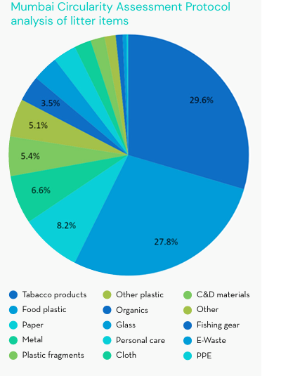
3. Data Collection​
• Secondary Data:​
• Sources: Research papers, government reports, and industry publications.​
• Tools: Data aggregation and trend analysis.​
• Primary Data (if included):​
• Surveys using structured questionnaires.​
• Focus group discussions with urban waste workers and residents.
4. Key Research Questions​
• What are the main challenges in waste management in Rajasthan and Maharashtra?​
• How can waste-to-energy solutions be scaled effectively?​
• What is the role of policy and community participation in sustainable waste management?​
• Can AI-driven solutions and biomass projects improve outcomes?​
​

Slide 15
5. Analysis Plan​​
• Quantitative Analysis:​​
• Analyze waste generation trends, recycling rates, and energy output from waste projects.​​
• Qualitative Analysis:​​
• Assess stakeholder perspectives on current policies and operational gaps.​​
​​
​​
6. Expected Outcomes​​
• Detailed understanding of challenges and opportunities in waste management.​​
• Strategic recommendations for implementing sustainable and scalable solutions.​​
• Framework for integrating technology and community participation.

Slide 16
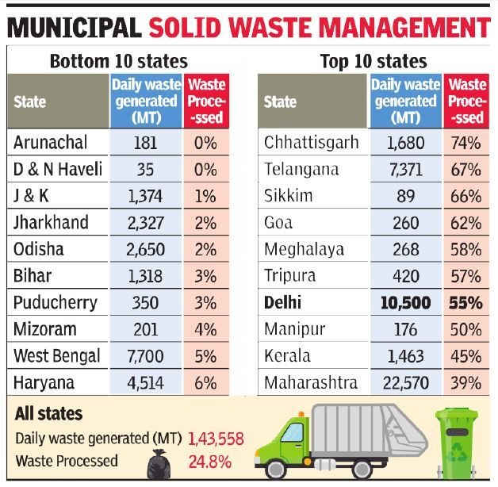
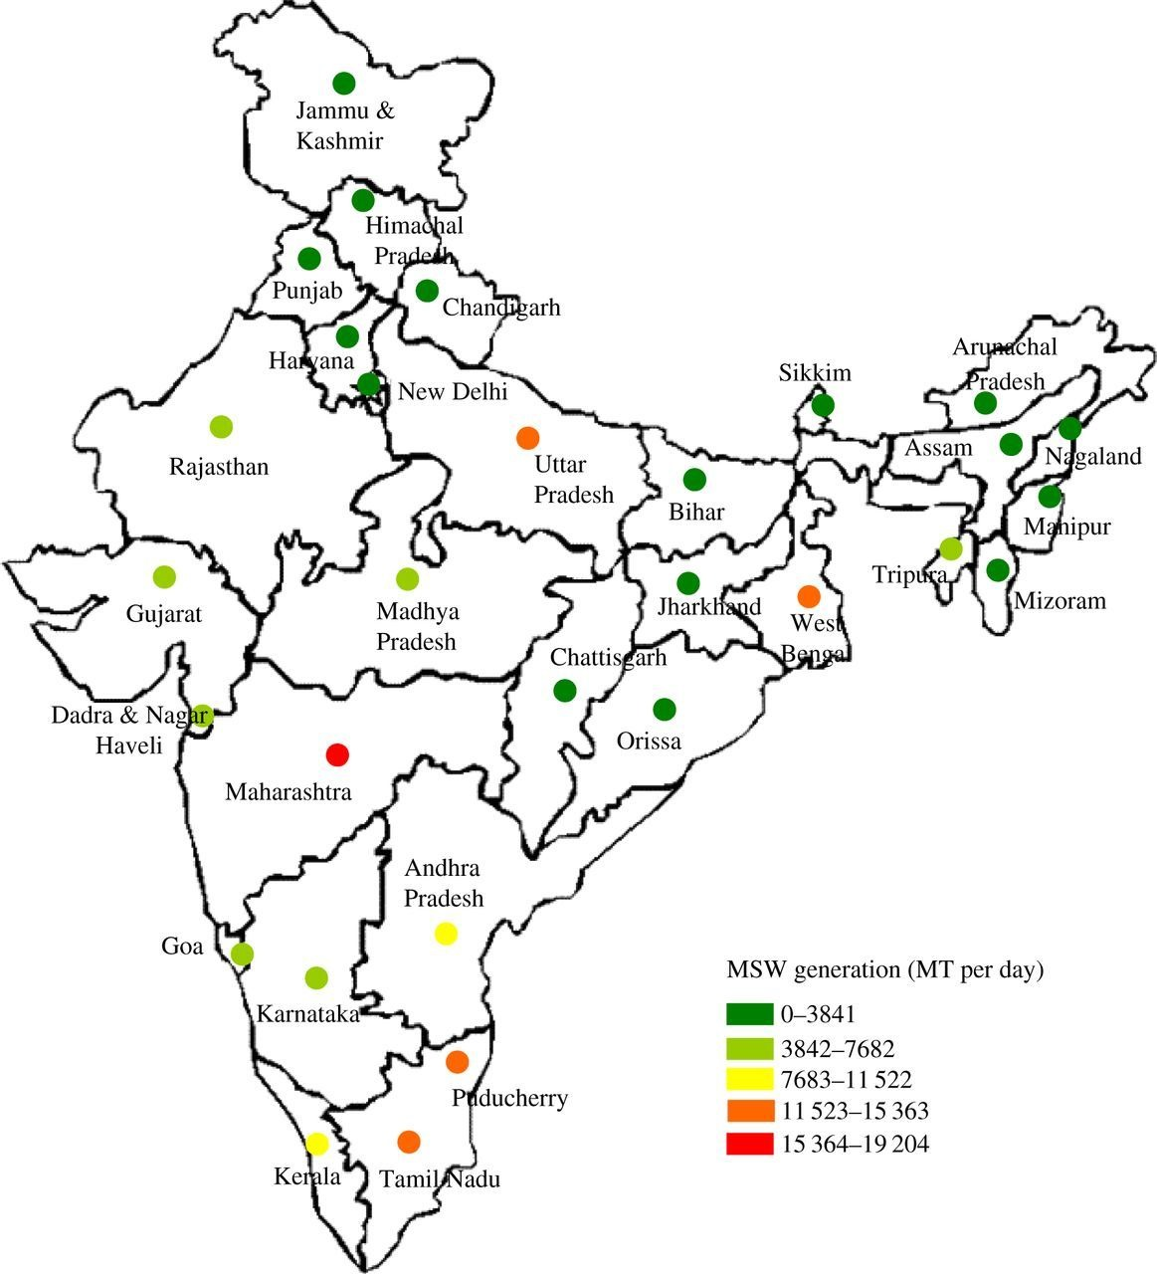



FIG:MSW Generation in different states

Slide 17
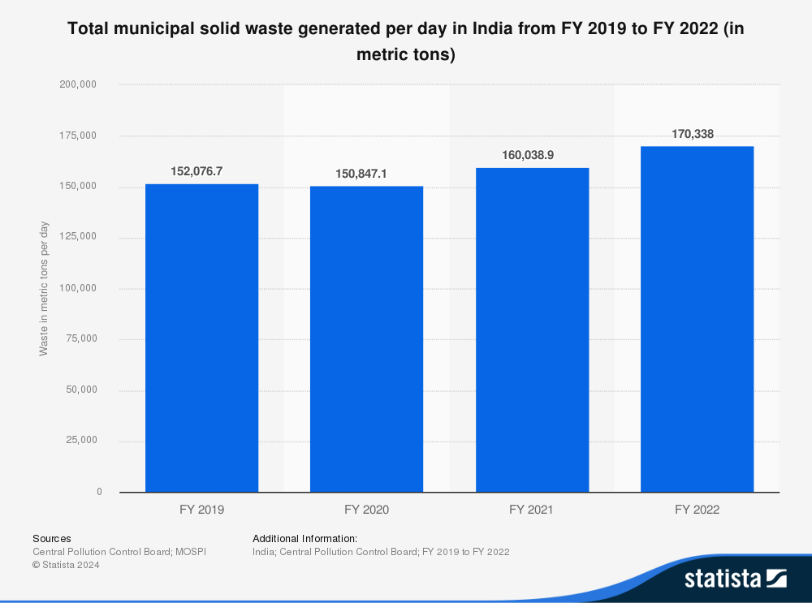
Key Insights:
Growth Trajectory
Significant 12% increase over 4 years
Daily waste generation rose from 152,076 to 170,338 metric tons
Adds pressure: Extra 18,261 tons per day by 2022
Notable Patterns
Initial pandemic dip (FY 2020): -0.8% decline
Strong post-pandemic rebound:
FY 2021: +6.1% growth
FY 2022: +6.4% growth
Critical Implications
Accelerating urbanization driving waste increase
Growing strain on existing disposal systems
Urgent need for infrastructure expansion
Essential to implement sustainable solutions

Slide 18
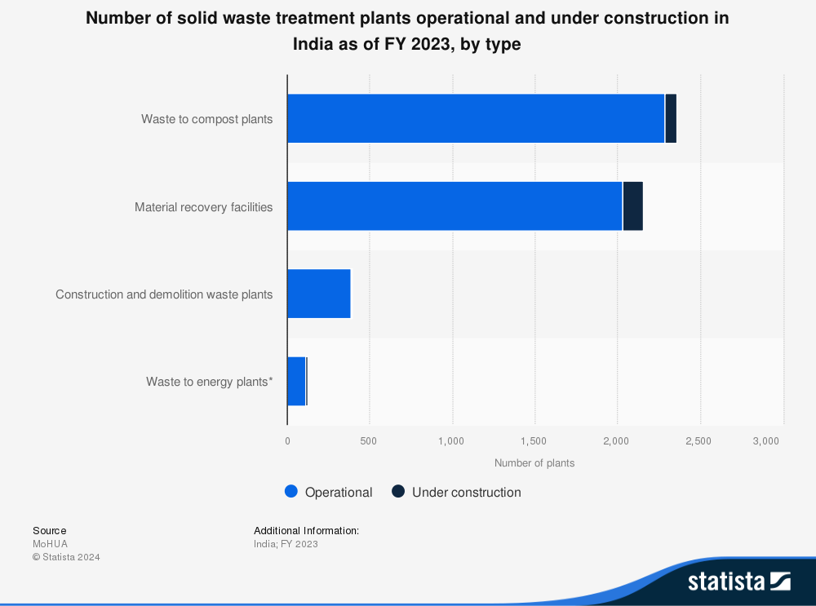
Key Insights:
Distribution of Treatment Facilities
Composting leads with 2,500+ operational plants
Material recovery follows with 2,200+ facilities
Construction & demolition waste plants: ~400 units
Limited waste-to-energy infrastructure (<200 plants)
Infrastructure Growth Pattern
Current focus heavily weighted toward traditional methods
Modest ongoing expansion across all facility types
Notable gap in modern waste-to-energy solutions
Clear emphasis on composting and material recovery
Strategic Implications
Strong organic waste management capacity
Growing recycling infrastructure
Underutilized energy recovery potential
Need for technological diversification

Slide 19
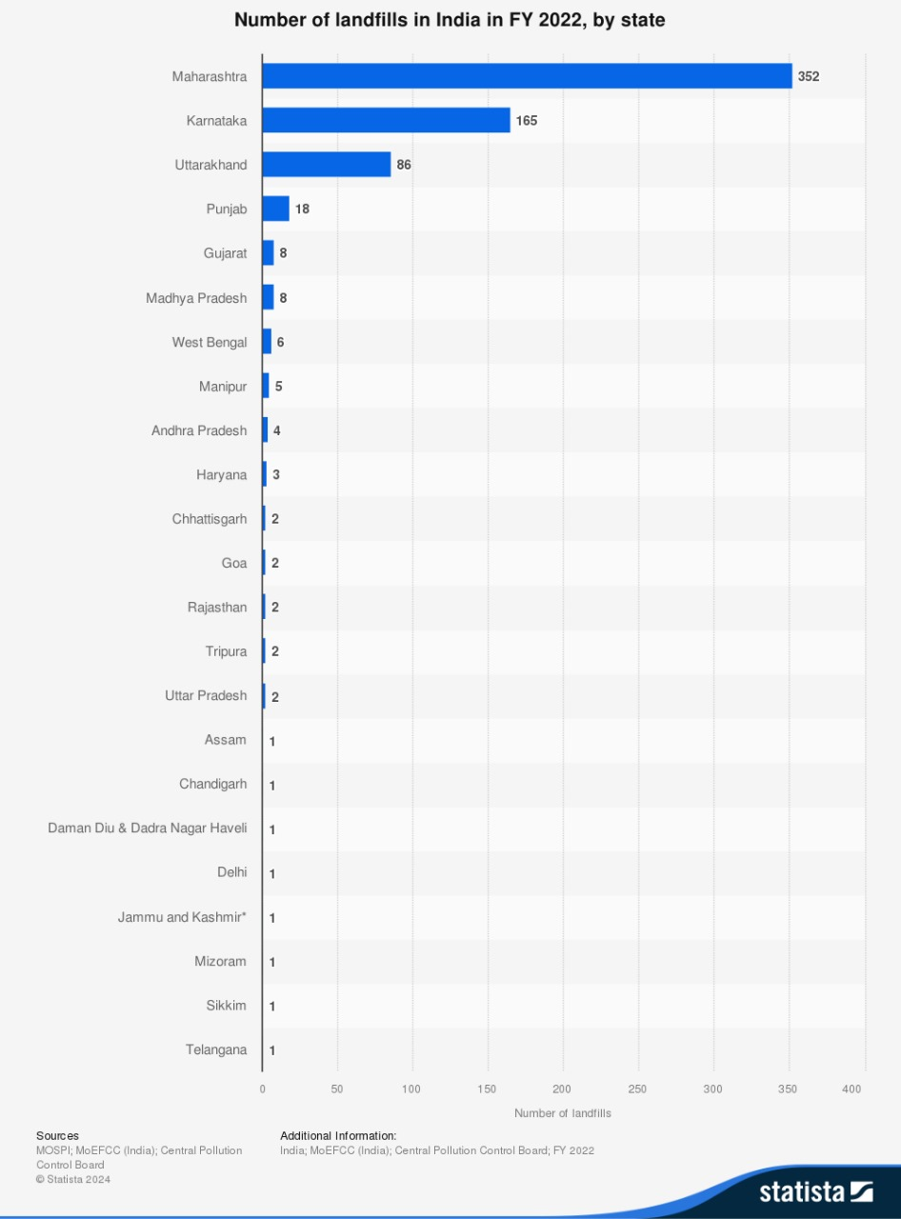
Key Findings
Regional Concentration: Maharashtra and Karnataka together account for 517 landfills (67% of total), highlighting significant regional disparity
Infrastructure Gap: 12 states/UTs have only 1 landfill each, raising concerns about waste management capacity
Population vs. Infrastructure: Major states like UP (most populous) have disproportionately few facilities (only 2 landfills)
Implications
Environmental Risk: Insufficient facilities may lead to improper waste disposal and environmental degradation
Development Need: Urgent infrastructure development required in states with minimal facilities
Policy Focus: Need for national waste management strategy to address regional imbalances

Slide 20
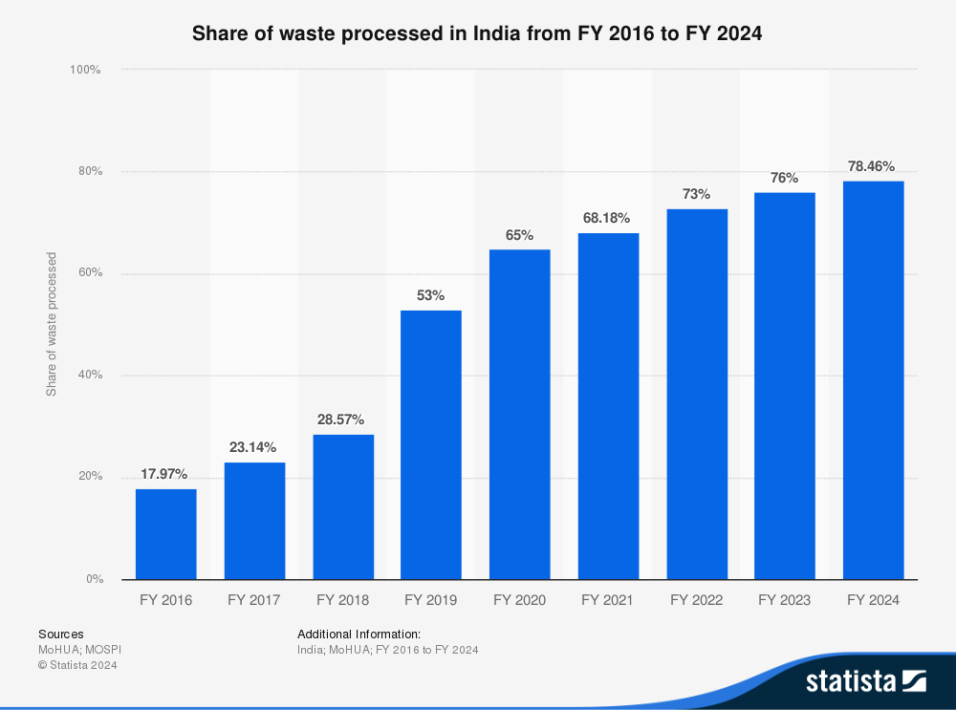
Key Insights:
The share of waste processed in India increased from 17.97% in FY 2016 to 78.46% in FY 2024, reflecting significant improvements in waste management.
A sharp rise occurred between FY 2018 and FY 2019 (28.57% to 53%), indicating major policy interventions.
Post FY 2020, growth remained steady, reaching 78.46% in FY 2024, showing sustained efforts in waste processing.
The progress aligns with initiatives like Swachh Bharat Mission (SBM), driving better waste segregation, recycling, and infrastructure development.
Nearing 80% waste processing coverage, India is reducing landfill dependency and moving towards sustainable waste management.

Slide 21
Data Analysis
BMC
KDMC
Matunga Ward (BMC) collects 270 metric tonnes of solid waste daily
Only 10% of the collected waste is suitable for manure, fertilizer, or recycling.
Workforce distribution in BMC: 25% trucks, 75% labour for collection and segregation.
36 NGOs and 476 labourers work under Matunga’s BMC, alongside other collaborating groups.
KDMC collects approximately 600 metric tonnes of solid waste daily.
Only 12% of the collected waste is suitable for composting, recycling, or energy recovery.
Workforce distribution: 30% trucks and 70% labourers engaged in collection, transportation, and segregation.
KDMC works in collaboration with 50 NGOs and employs over 1,200 labourers for effective solid waste management. Other groups, including local volunteers and private contractors.

Slide 22
Data Analysis (Contd).
Challenges in Front of Municipalities:
Poor road conditions hinder the use of advanced waste-collecting trucks.
Public shows inconsistency in adhering to waste management policies.
Low civic sense and awareness among the public.
Residential areas resist segregation and compliance with waste policies.
Focus remains on immediate issues, neglecting root causes.
Initiatives to create awareness are less effective in areas like Dharavi.
Maintenance of waste collection equipment is inadequate, often damaged by laborers.

Slide 23
Tech. used by Municipalities
Waste-to-Energy Plant
RFID and SWM Technology
Biogas plants to convert organic waste into electricity and manure.
Introduced pyrolysis technology to process non-recyclable plastics into fuel or other byproducts.
The electricity generated is used in BMC canteens.
Tracking waste collection vehicles and holding accountable using GPS and RFID.
Waste Collection Vehicles Monitoring.
Street Sweeping and Sanitation.
Employee Attendance and Accountability.
Vehicle Tracking Systems
Advanced Incineration
Real-time tracking ensures vehicles adhere to designated routes and schedules.
SMS-Plasma technology for efficient waste management.
Using the technology to efficiently manage hazardous and non-recyclable waste to ensure minimal environmental impact.

Slide 24
Themes and opportunities, spaces identification
THEME - URBAN WASTE MANAGEMENT
Segregation and Recycling: Potential for enhanced waste segregation systems and partnerships with NGOs to increase recycling.
Technology Integration: Using IoT-based smart bins, AI sorting mechanisms, and plasma incineration to address mixed waste challenges.
Public Awareness and Education: Emphasizing campaigns to improve civic sense and drive community participation.
SPACES
Residential Societies: Incentivizing segregation and on-site composting with property tax rebates, as seen in Kalyan and Dombivli.
Slum Areas: Introducing community-based waste collection programs and education drives in high-density, underserved areas.
Commercial Establishments: Leveraging waste audits and compliance measures for better waste segregation and management in restaurants and shops.
OPPORTUNITIES
Circular Economy Models: Developing markets for recycled products and energy from waste to create revenue streams.
Sustainable Development: Implementing biogas and composting units to reduce landfill dependency and create local energy solutions.

Slide 25
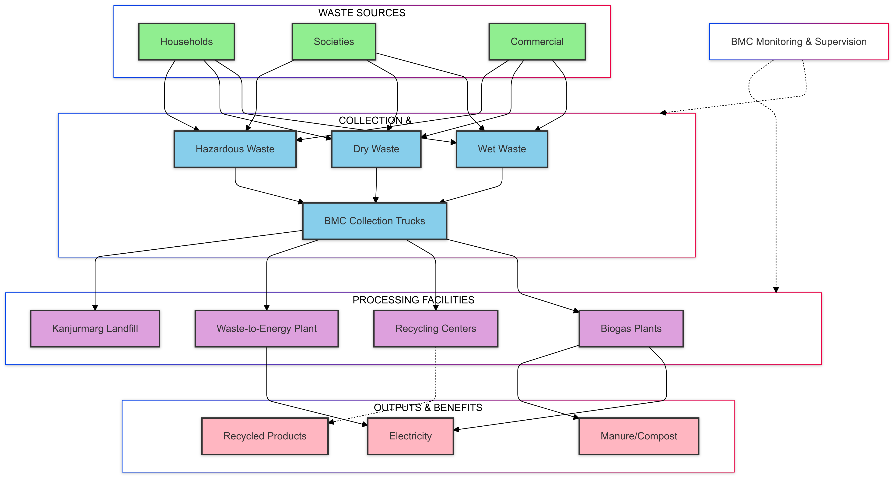
BMC's Integrated Waste Management System

Slide 26
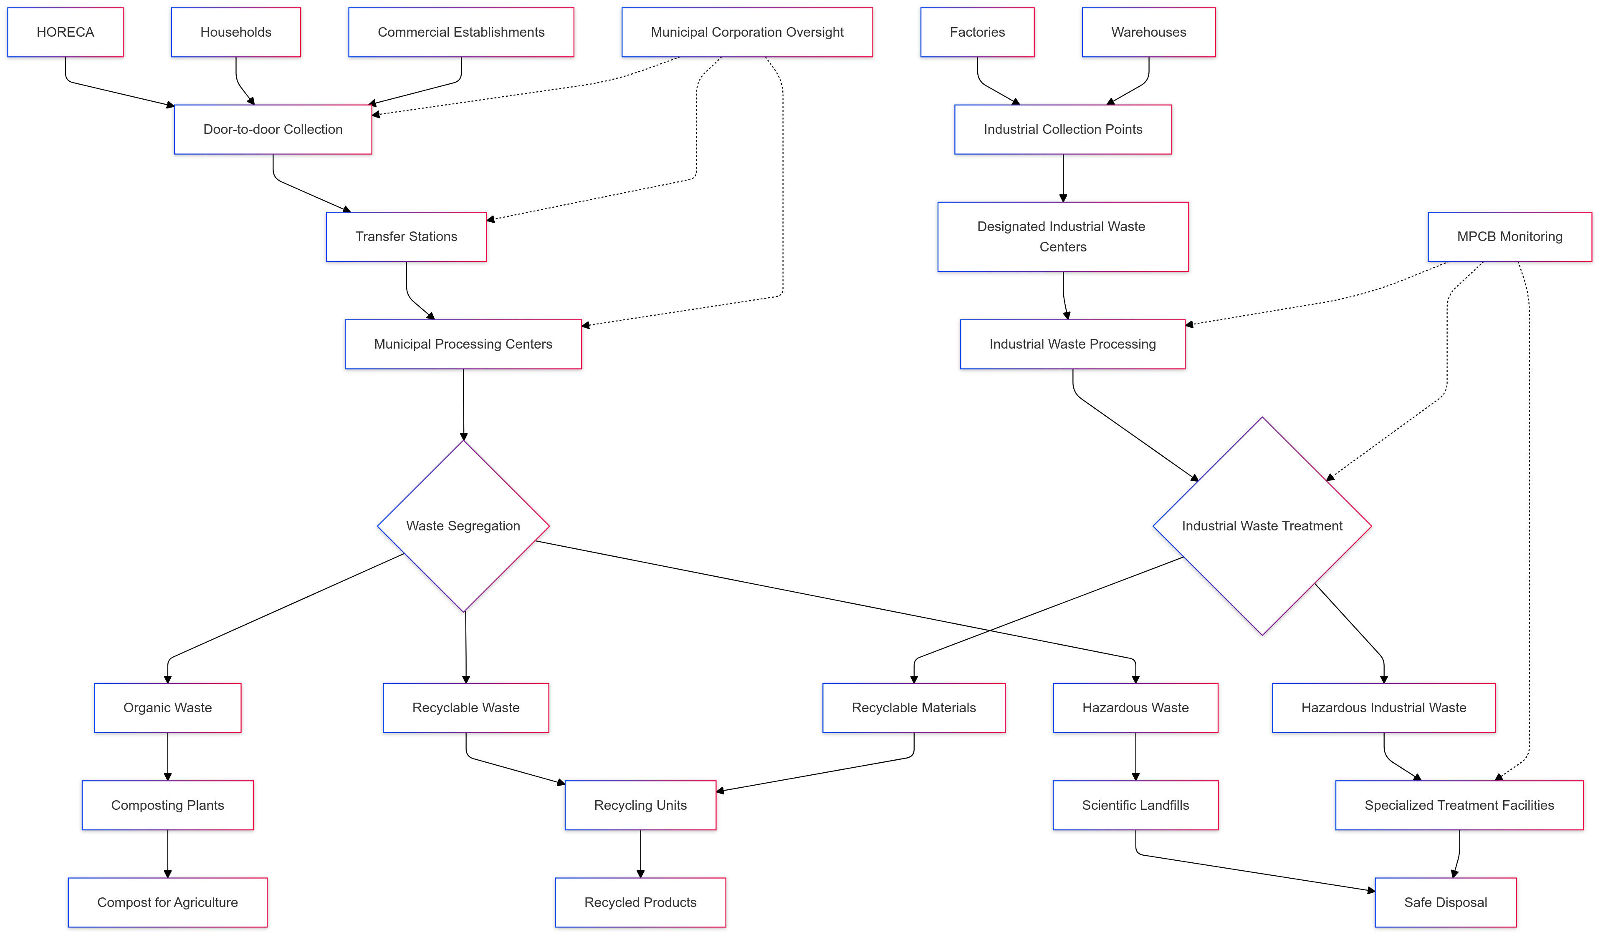
Urban Waste Management journey in Maharashtra

Slide 27
Thanks!
PAPER

